Slide 1
TOA fluxes on ISCCP-NG L1g grid
Nicolas Clerbaux, Tom Akkermans, William Moutier
and the Remote Sensing from Space team.
Royal Meteorological Institute of Belgium (RMIB)
ISCCP-NG Workshop
EUMETSAT, 29 Feb. 2024.

Slide 2
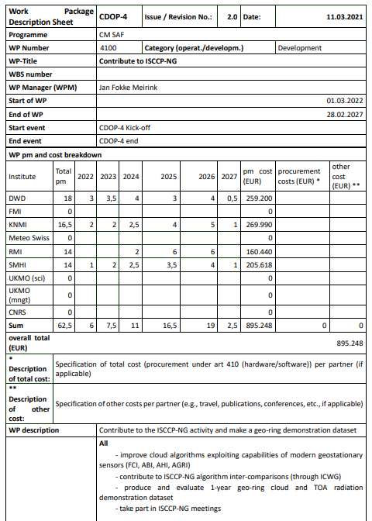
Content
Rationales for TOA radiation products in ISCCP-NG
ISCCP & ESA CCI radiation products
The EarthCARE mission and flux “closure” concept
Product’s requirements and algorithm design
Preliminary NB→BB results for GOES/ABI, Himawari/AHI, MSG/SEVIRI and MTG/FCI
Plans for 2024-2026
Brief discussion of L1g format for TOA radiation
Summary

Slide 3
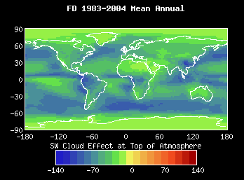
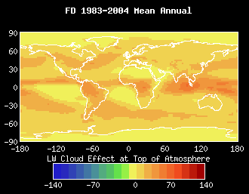
Rationales – ISCCP Radiation Products
Historical : ISCCP-FD
ISCCP-FH products (2013)
ESA Cloud CCI fluxes
What can go wrong with fluxes and CRE ?
Radiation modelling, e.g. 3-dim effects
Aerosols and surface properties, …
Sensitivity in the (non) retrieved cloud properties
Dependency on NWP, e.g. for H2O profile
(…)
Interest to evaluate the fluxes where possible, i.e. at surface (e.g. BSRN) and at TOA
Concept of closure at TOA, as in the EarthCARE mission

Slide 4
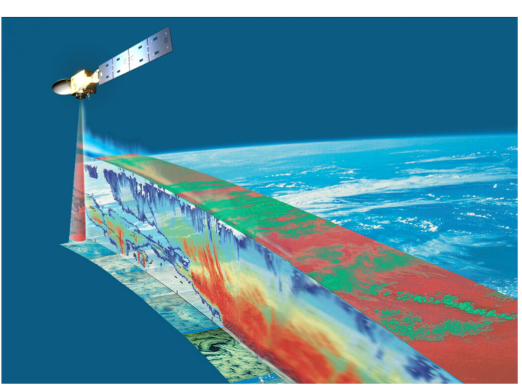
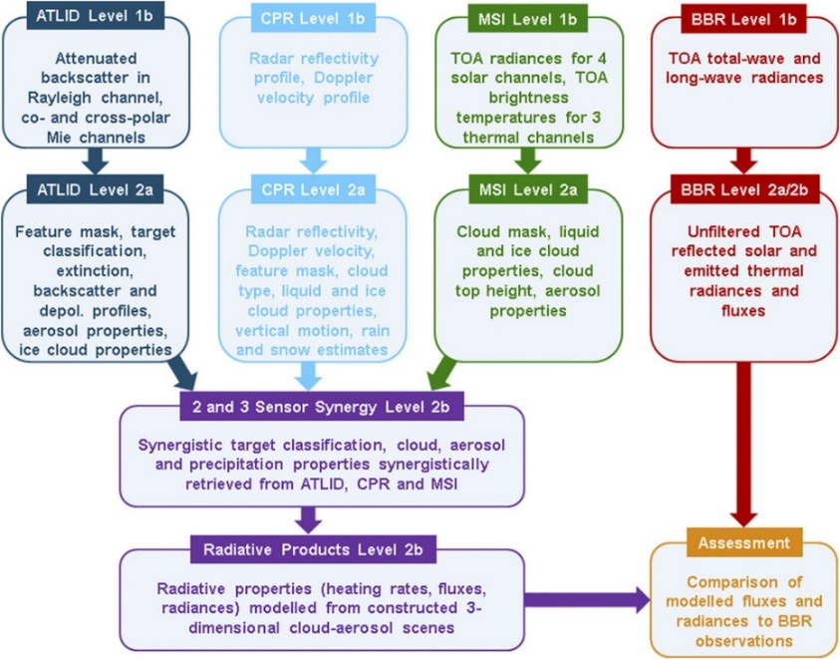
Rationale – EarthCARE Closure at TOA
EarthCARE main processing steps:
Vertical profiles of cloud and aerosols using CPR and ATLID
Horizontal context using the MSI
3-dim scene reconstruction
Atmospheric heating rate and TOA fluxes from radiative transfer computations (Monte Carlo)
Comparison (closure) of the TOA fluxes with the BBR instrument
Accuracy 10 W/m² for 10 x 10km domains
BBR fluxes estimated from 3 views
Notes:
Closure at surface is also possible

Slide 5
Product requirements and algorithm design
Radiance and fluxes shall be Empirical
i.e. not based on the RTM
limited use of (ISCCP-NG) cloud/aerosol products for ADM
Instantaneous flux accuracy ~10 W/m² (not feasible)
State-of-the-art processing for NB → BB and Angular Dependency Models (ADMs)
Able to process the full diurnal cycle
Note : closure is also possible in radiance (if ISCCP-NG radiation products provide radiance)
Accuracy not necessary consistent across satellites on the GeoRing
Uncertainty needed for the closure process.
Product evaluation wrt CERES (PSF ~20km), GERB (PSF ~45km), EarthCARE BBR (configurable to match the 0.05°x0.05° domains), overlaps between satellites.
ISCCP-NG L1g files
(GEO level 1 files)
ISCCP-NG
Cloud products
NB→BB
thermal
NB → BB
solar
Radiative
Transfer Models
improvement
ADM
thermal
ADM
solar
L2 RSF and OLR
Closure assessment at TOA

Slide 6
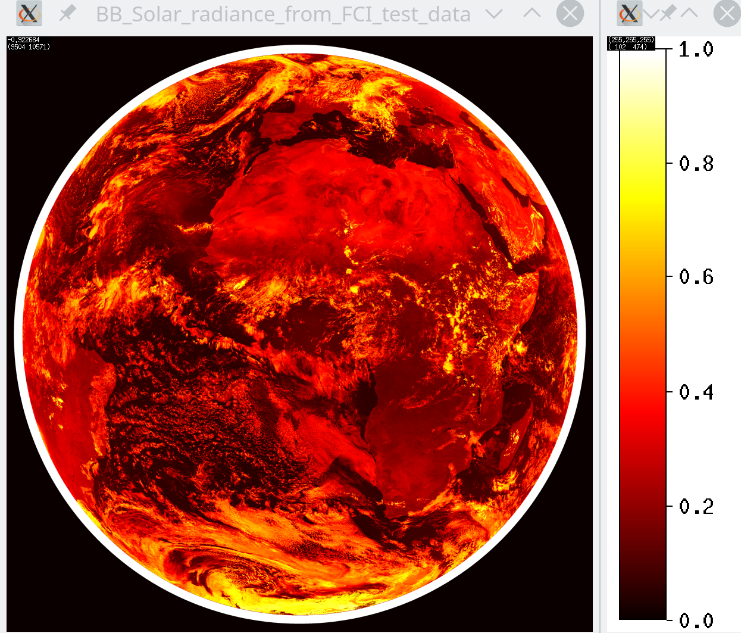
Theoretical investigations: NB → BB for solar rad.
Preliminary investigations based on a dataset of simulated spectrums.
Satellite/imager | # solar channels | No noise | 1st order 5% noise | 2nd order 5% noise
MSG/SEVIRI | 3 | 5.1% | 5.1% | 4.3%
GOES16/ABI | 6 | 2.9% | 3.0% | 2.7%
Himawari-8/AHI | 6 | 3.9% | 4.4% | 4.1%
MTG/FCI | 8 | 0.9% | 1.0% | 0.7%
SNPP/VIIRS | 9 | 3.6% | 4.7% | 3.5%
Metop-SG/MetImage | 11 | 0.8% | 0.9% | 0.8%
BB reflectance (ρ_{BB} ) estimated from FCI test data on 20.09.2017 12:00 UTC
Himawari/AHI seems closer to MSG/SEVIRI than to GOES/ABI
MTG/FCI and EPS-SG/MetImage channels look very promising for solar radiation
Example for FCI at SZA=30°, VZA=30°, RAA=90° :
ρ_{BB} = 0.00619 + 0.18980 ρ_{0.4µm} + 0.11731 ρ_{0.5µm}+0.14371 ρ_{0.6µm} + 0.10182 ρ_{0.8µm} + 0.21284 ρ_{0.9µm} + 0.05102 ρ_{1.3µm} + 0.07835 ρ_{1.6µm} + 0.03839 ρ_{2.2µm}
ρ_{0.9µm} has the highest weight in the regression
Notes:
GERB SW channel unfiltering RMS error of ~0.5% (Clerbaux et al., 2008)

Slide 7
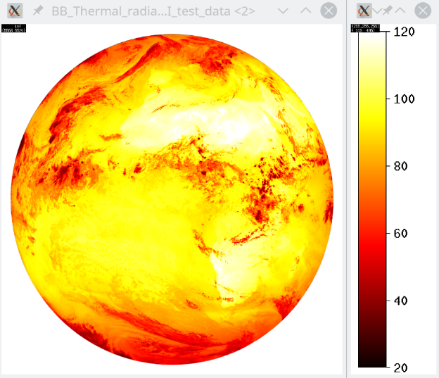
Theoretical investigations: NB → BB for thermal rad.
Preliminary investigations based on a dataset of simulated spectrums.
Satellite/imager | # thermal channels | No noise | 1st order 5% noise | 2nd order 5% noise
MSG4/SEVIRI | 7 | 1.2% | 1.2% | 0.7%
GOES16/ABI | 9 | 1.3% | 1.3% | 0.7%
Himawari-8/AHI | 9 | 1.3% | 1.3% | 0.7%
MTG-I1/FCI | 7 | 1.3% | 1.3% | 0.8%
SNPP/VIIRS | 4 | 2.9% | 3.9% | 3.2%
Metop-SG/VII (MetImage) | 6 | 1.4% | 1.4% | 1.1%
Very similar results over the GEO-ring
VIIRS suffers from missing H₂0 bands
BB thermal radiance estimated from FCI
Notes:
Note : GERB LW channel unfiltering RMS error of ~0.1% (Clerbaux et al., 2008)

Slide 8
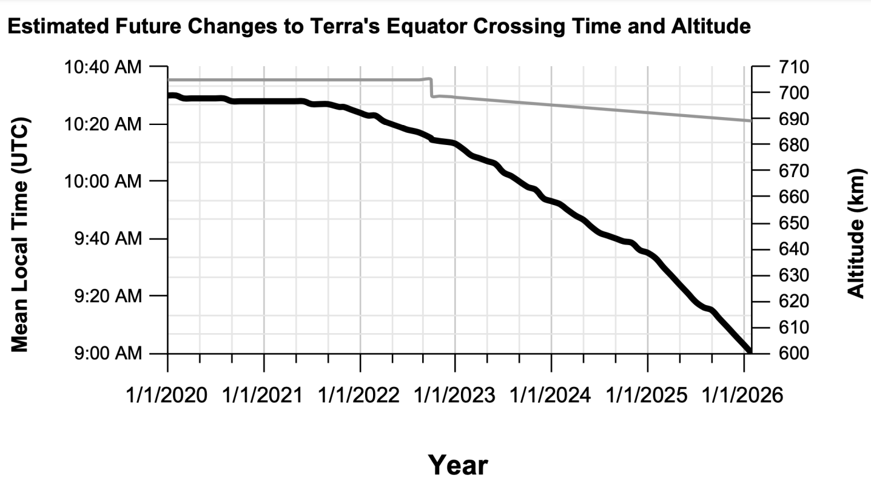
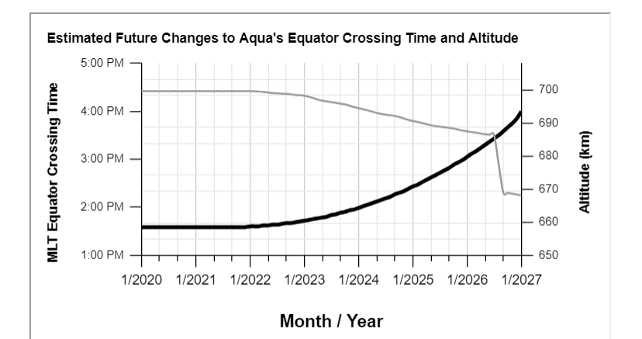
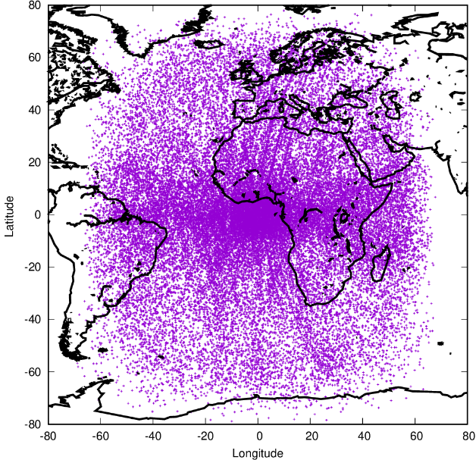
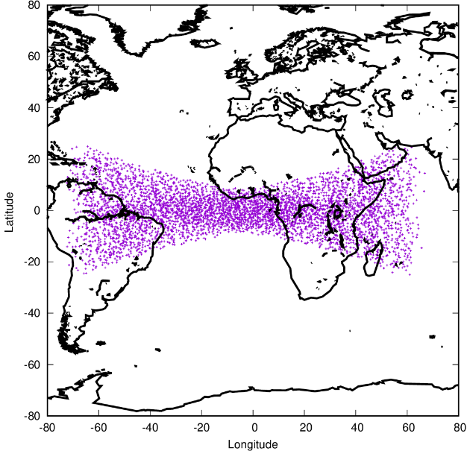
Development of empirical NB → BB regressions
CERES observations from (drifting) Terra and Aqua in Rotating Azimuth Plane (RAP) mode.
Terra-FM2 mostly in RAPS since Nov. 2021
Aqua-FM3 mostly in RAPS since Apr. 2023
Collocated in space, coangular (max angle < 3°), time (< 300s).
Applied to GOES-16, GOES-18, Himawari-9, MSG3 (0°), MSG2 (45.5°E) and MTG-I1 (commissioning)
Coangular observations between GEO and LEO imager in:
Cross-track mode
RAP mode

Slide 9
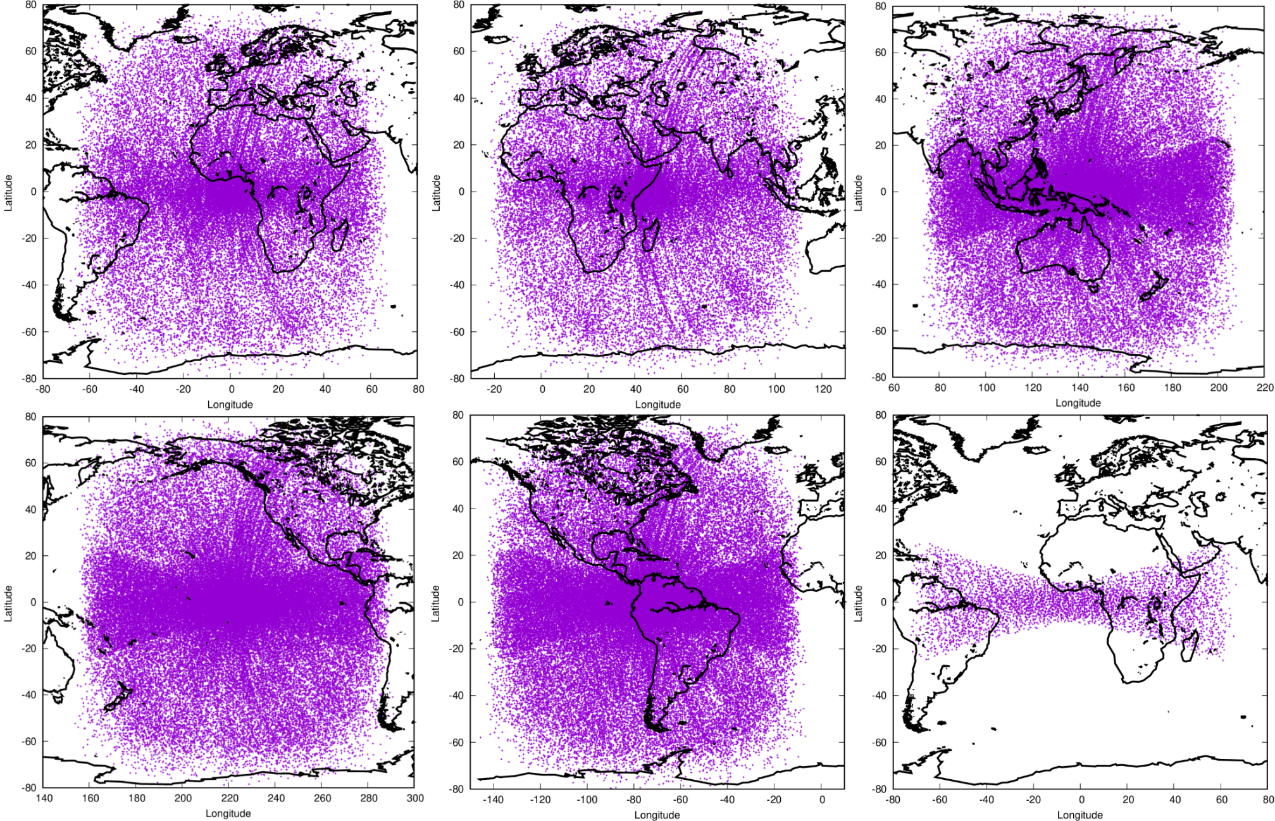
Development of empirical NB → BB regressions
Note : subsampling by 100 (i.e. much more matches)
Notes:
One out of 1 hundred

Slide 10
Development of empirical NB → BB - Solar rad.
Satellite | # | Long. | # matches | RMSE (%)
 | ch |  |  | all | ocean | land | desert | vege
MSG3 | 3 | 0° | 156 708 | 6.3 | 7.4 | 4.8 | 3.5 | 4.8
MSG2 | 3 | 45.5° E | 161 003 | 5.7 | 7.1 | 5.0 | 3.8 | 4.9
HIMAWARI-9 | 6 | 140.7°E | 170 942 | 7.4 | 7.6 | 6.6 | 4.5 | 6.8
GOES-18 | 6 | 137° W | 174582 | 8.9 | 8.7 | 8.9 | 8.5 | 9.0
GOES-16 | 6 | 75°W | 211476 | 7.3 | 9.9 | 5.0 | 7.0 | 4.9
MTG (commissioning) | 8 | 3.4°E | 10 970 | 3.8 | 4.9 | 3.1 | 2.0 | 3.1
MSG results as expected
The expected improvements with AHI & ABI not observed wrt CERES, especially with GOES-18/
Promising results with MTG/FCI are confirmed

Slide 11
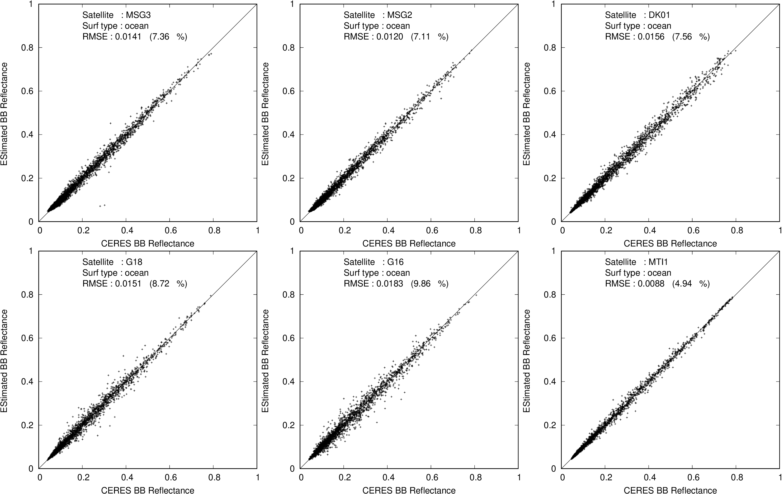
Development of empirical NB → BB - Solar rad.

Slide 12
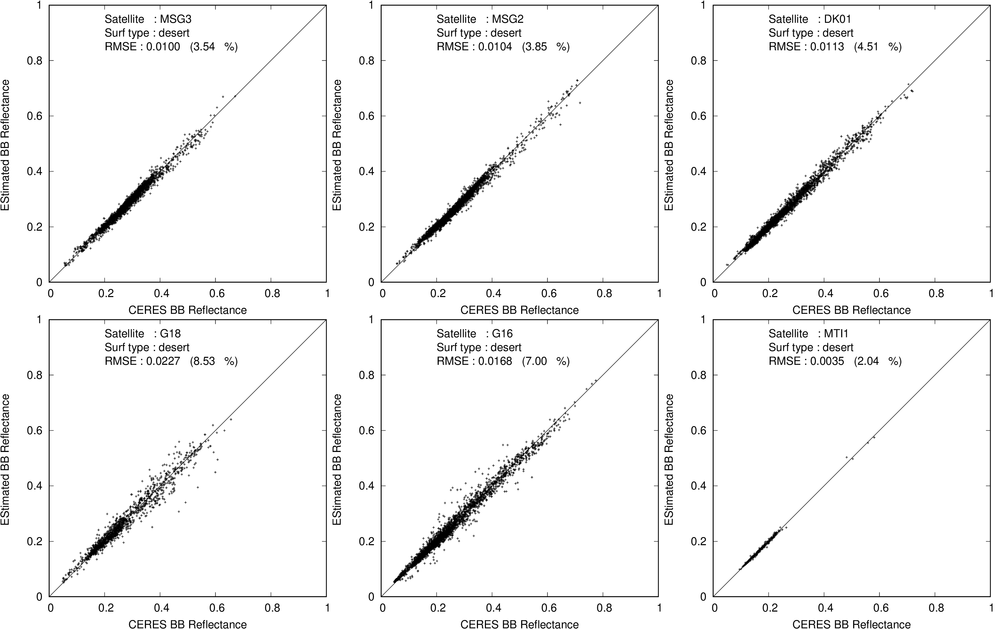
Development of empirical NB → BB - Solar rad.

Slide 13
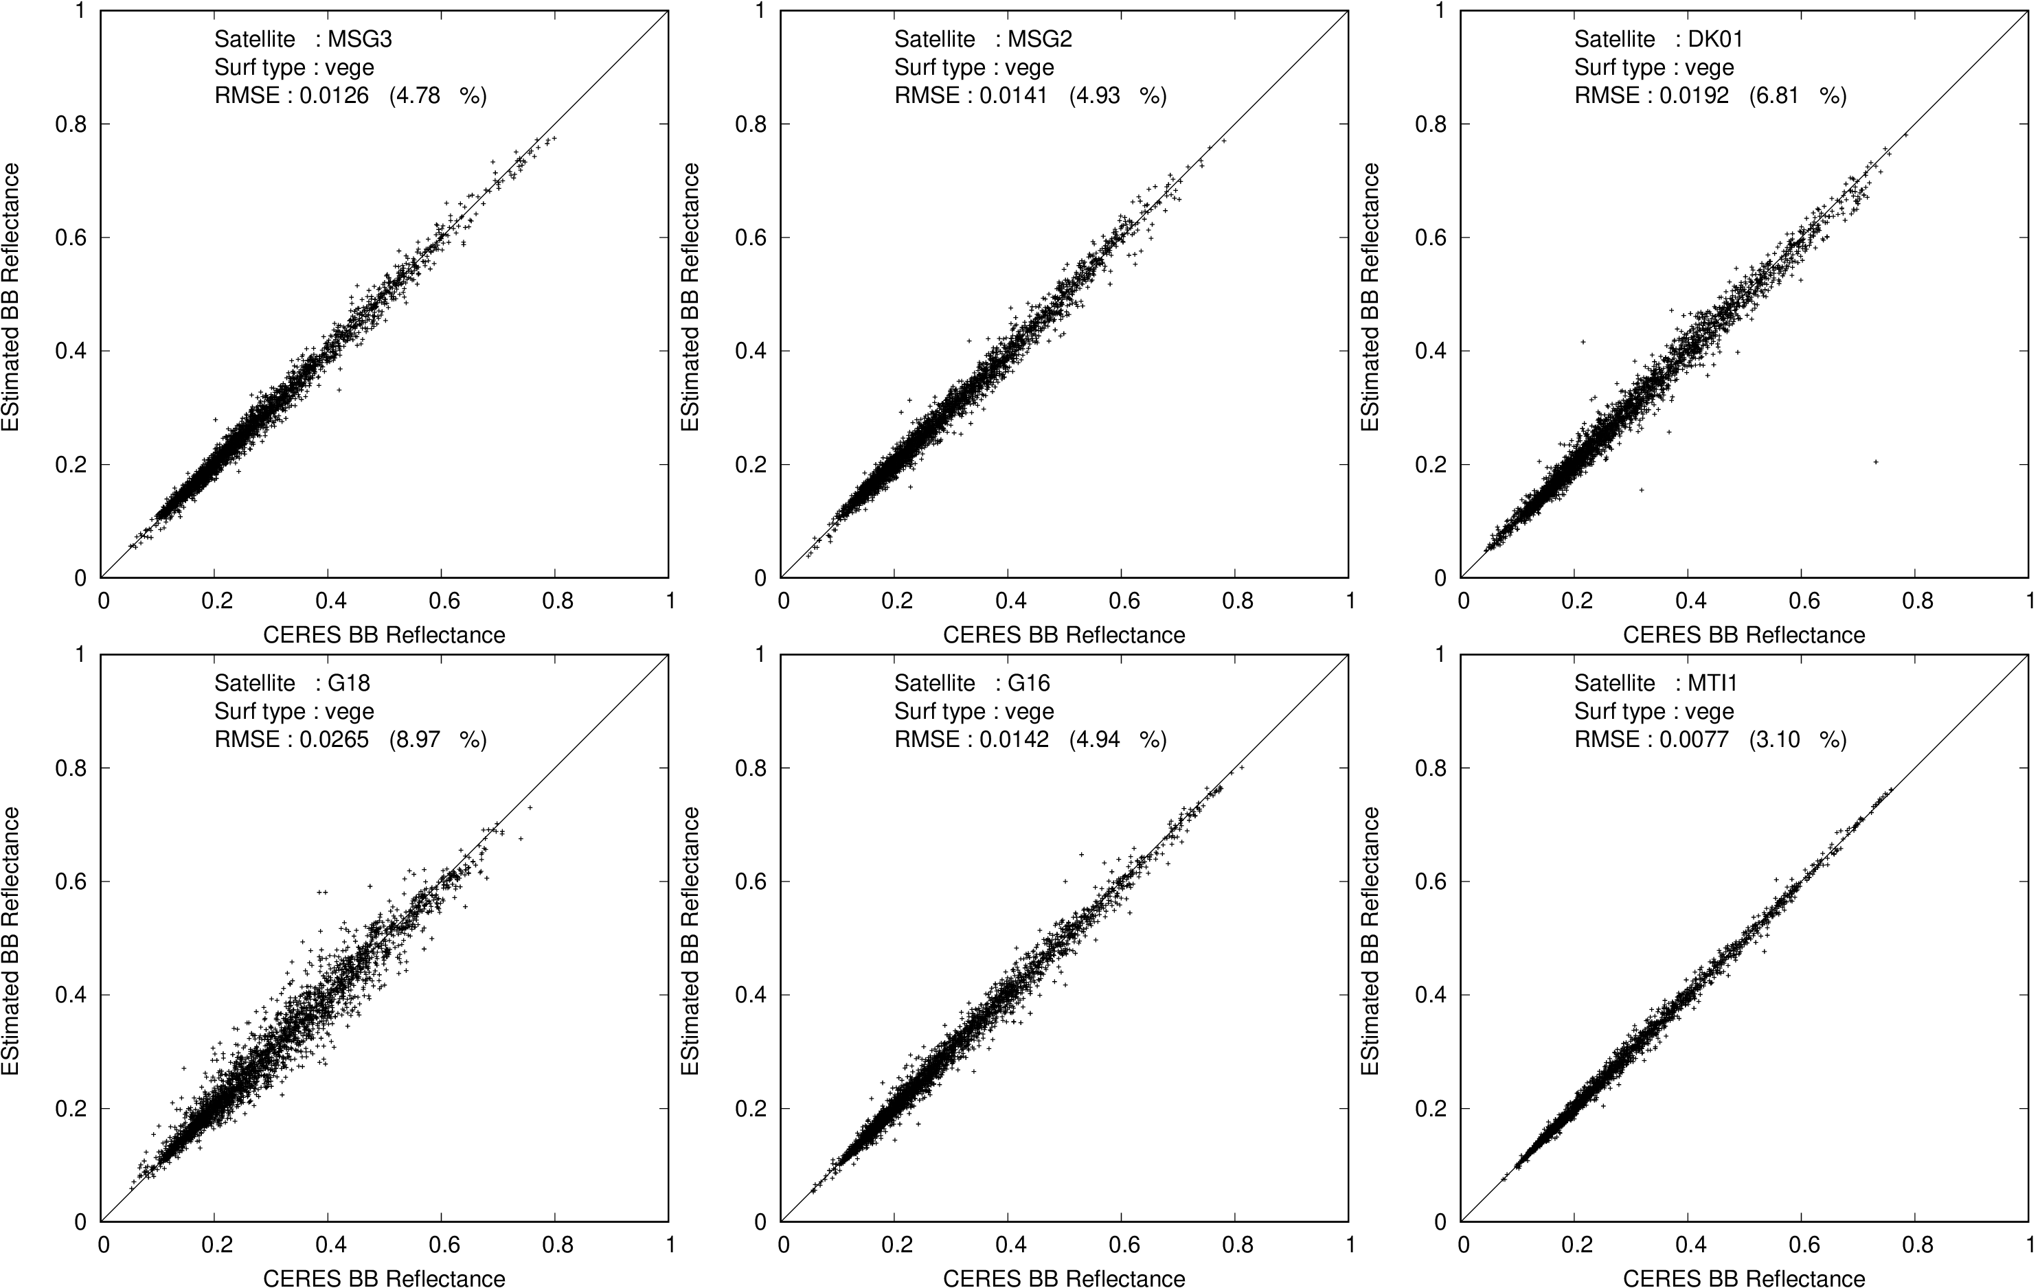
Development of empirical NB → BB - Solar rad.

Slide 14
Development of empirical NB → BB - Thermal rad.
Satellite | # | Long. | # matches | RMSE (%)
 | ch |  |  | all | ocean | land | desert | vege.
MSG3 | 7 | 0° | 406 566 | 2.5 | 2.5 | 2.1 | 1.6 | 2.3
MSG2 | 7 | 45.5° E | 427 910 | 5.6 | 5.9 | 5.0 | 1.9 | 5.7
HIMAWARI-9 | 9 | 140.7°E | 590 534 | 2.4 | 2.4 | 2.2 | 1.7 | 2.2
GOES-18 | 9 | 137° W | 645 559 | 2.3 | 2.2 | 3.4 | 2.9 | 3.5
GOES-16 | 9 | 75°W | 715 290 | 2.3 | 2.4 | 2.2 | 2.3 | 2.2
MTG (commissioning) | 7 | 3.4°E | 42 820 | 1.6 | 1.9 | 1.9 | 1.0 | 2.0
RMSE (%) in radiance/flux (= 4* RMSE (%) in brightness temperature)
MSG2 might suffers from high inclination
Better result for MTG/FCI probably due to equatorial restriction.

Slide 15
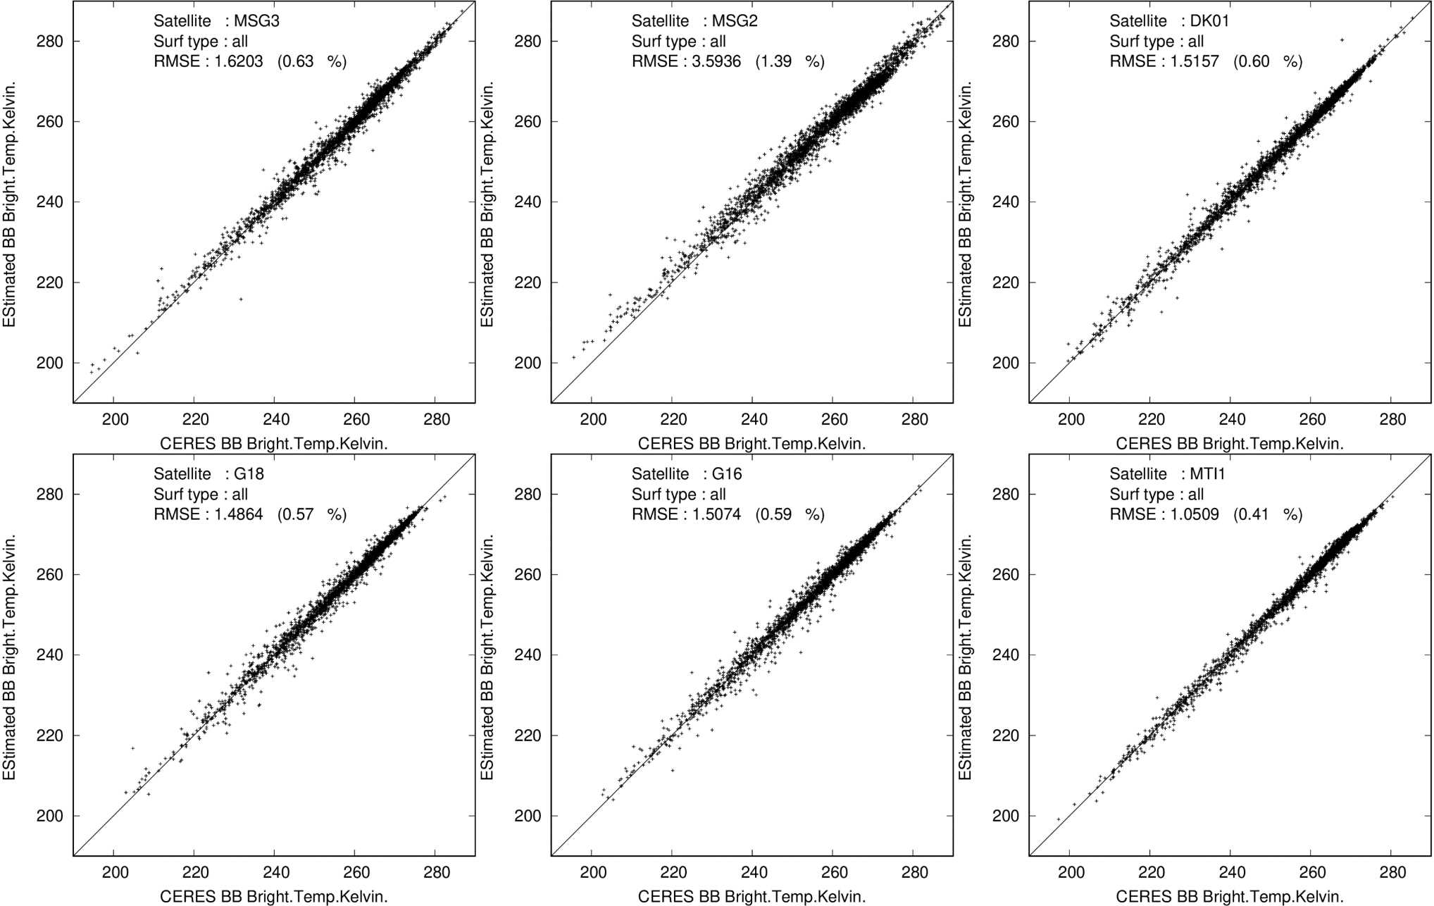
Development of empirical NB → BB - Thermal rad.

Slide 16
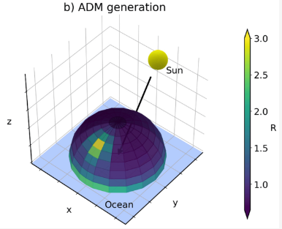
Angular Dependency Models for GEO geometry
ADMs for solar radiation
CERES TRMM models (592 scene types)
Surface type
Cloud fraction (0-100%)
Cloud optical depth @ 500nm
Cloud phase (water/ice)
CERES Terra Ed2 models
CERES Terra+Aqua Ed4 models
(Could be used for ocean, TBC)
ADMs for thermal radiation
CERES TRMM models
CERES Terra+Aqua Ed04 models
“Spectral models” based on theoretical simulations (e.g. as in EarthCARE, GERB)

Slide 17
Plans 2024 - 2026
Incorporate cloud products from CM SAF partners
Continue investigate / improve the NB → BB :
Incorporate more (drifting) Terra/Aqua data.
Use more cloud, surface, NWP information in the process.
Regressions per type of imager (GOES16+G18, MSG3+MSG2)
Account for geo satellite orbit inclination.
Follow / contribute to latest development of “GEO” ADMs:
CERES team
GERB ED02 processing (P. de Buyl)
CLAAS-4 team (Tom Akkermans, William Moutier)
Follow the EarthCARE BroadBand Radiometer activation and the possibility to derive BBR fluxes over the L1g grid.
Process and evaluate 1 year of ISCCP-NG L1g
Assess the closure concept when ISCCP-NG radiation products available.

Slide 18
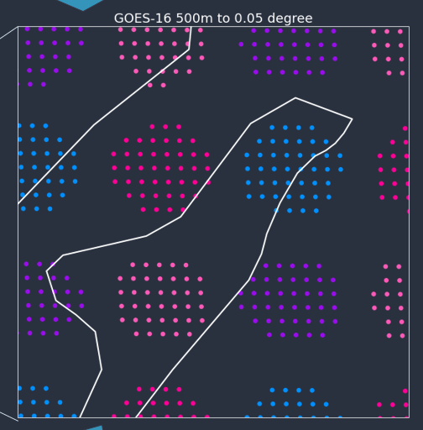
Discussion ISCCP-NG L1g format
L1g 30 minute repeat cycle :
okay for capturing the diurnal cycle
not optimal for NB→BB development
Ideally should be able to convert both way from / to the operational calibration
L1g with full spectral channels :
L1g with up to 3 layers :
L1g pixels:
Is the reconstructed ISCCP-NG “PSF” circular ?
In general we prefer rectangular pixels without gaps (e.g. as in CM SAF CLAAS 0.05°x0.05° products)
L1g sub-pixel information for 0.6µm and 11 µm can be interesting for:
Cloud fraction estimation.
Uncertainty estimate.

Slide 19
Summary
TOA radiation products are being developed on the GeoRing:
Satellite separately (up to 10’)
ISCCP-NG L1g grid (30’)
Preliminary narrowband → broadband conversion results:
MSG/SEVIRI as expected
GOES/ABI and Himawari/AHI results not as good as expected for solar rad.
MTG/FCI looks promising for solar rad.
ADMs will likely be the limiting factor for the instantaneous accuracy.
Closure in radiance to be investigated.
CERES data from drifting Terra and Aqua satellite will be very valuable, as well as the future EarthCARE BBR
EarthCARE Launch on
Falcon-9, 25-31 May 2024

