Slide 1
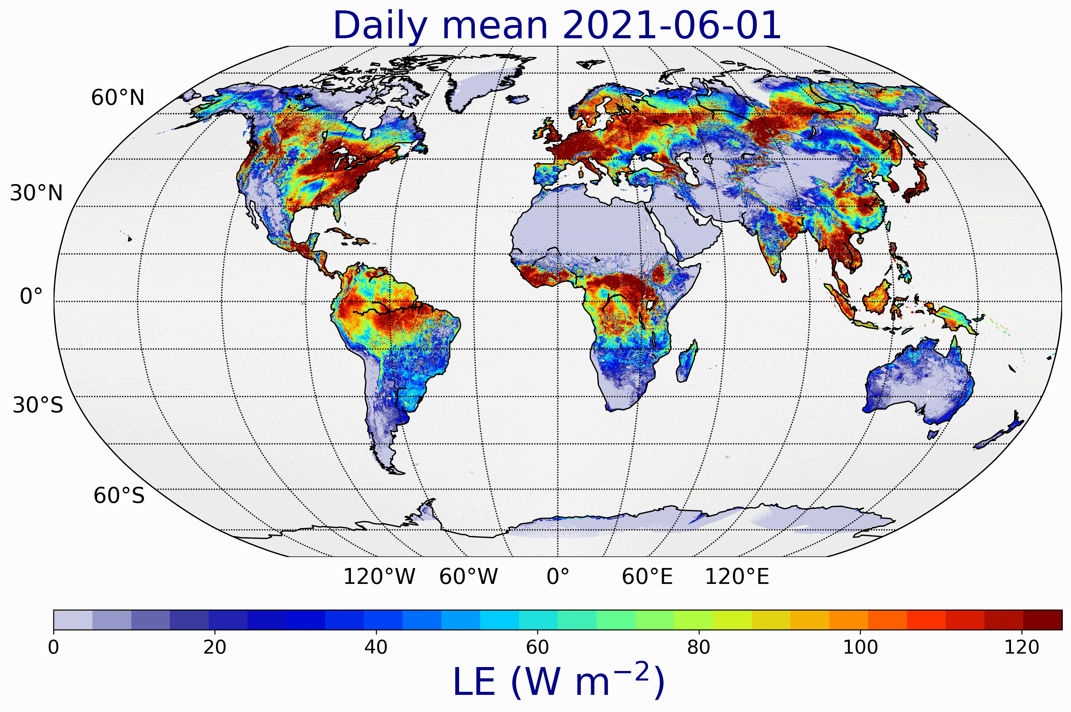
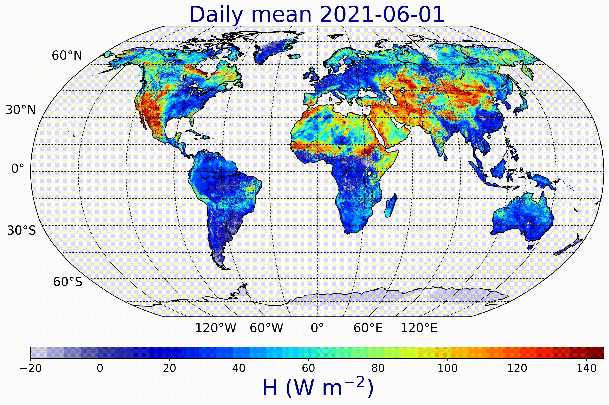
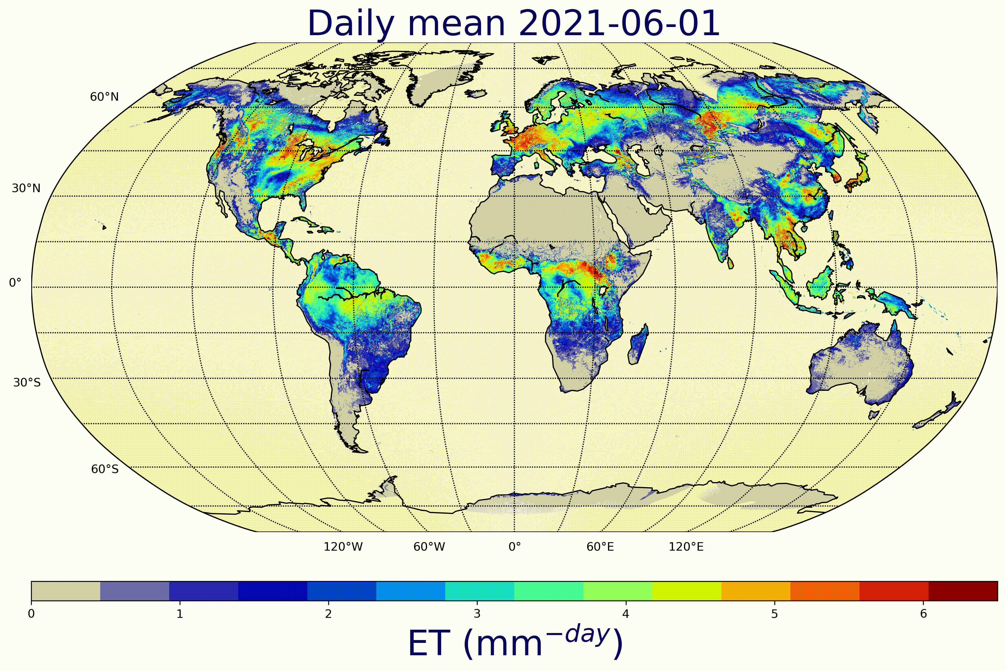

ET - LE - H variables

Slide 2
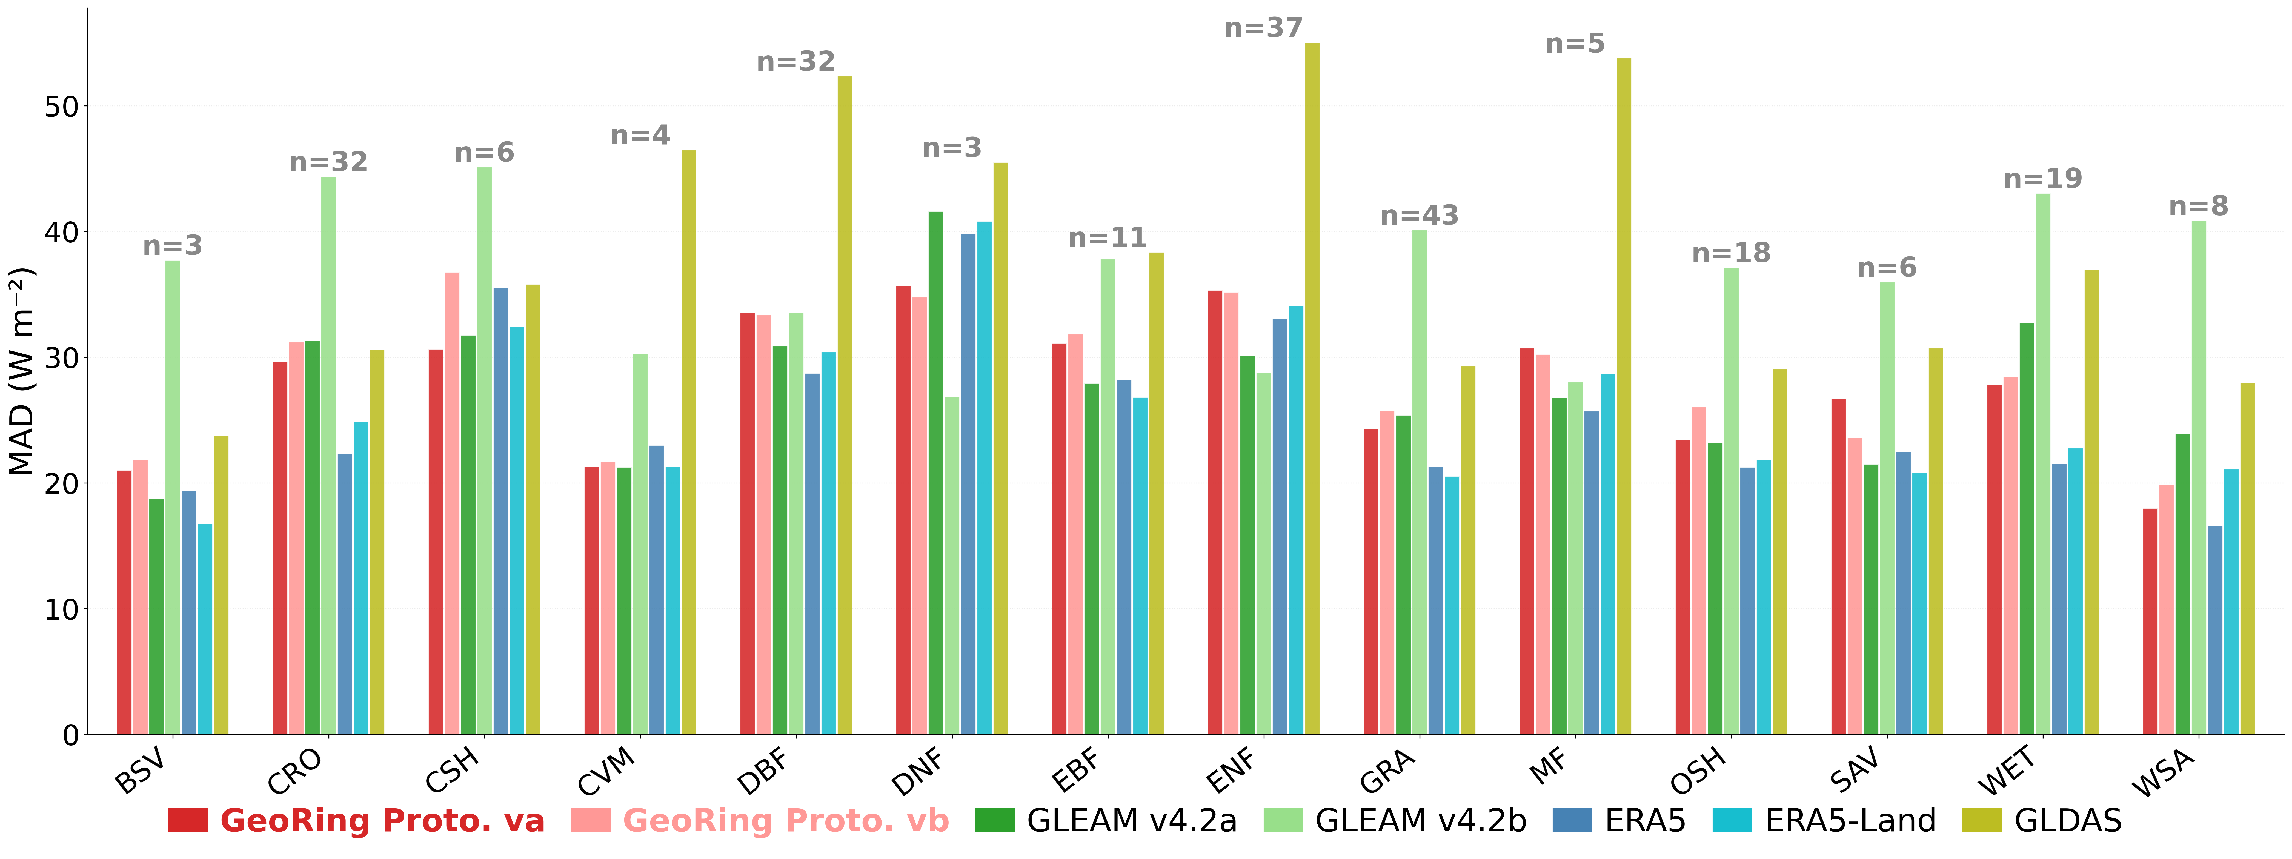
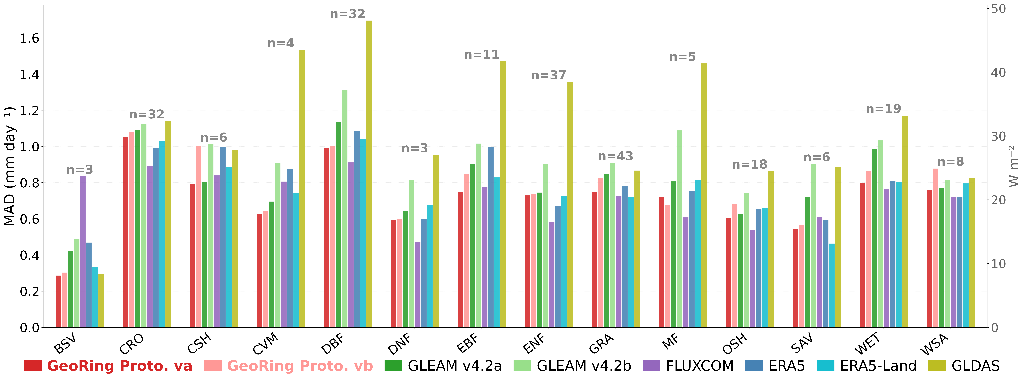
Preliminary results - Daily
Sensible heat flux (H)
Evapotranspiration (ET)
Validation against 227 stations over the globe
Meet state-of- the-art accuracy standards
Proto. va = ERA5-Land soil moisture input | Proto. vb = H-SAF soil moisture input.

Slide 3
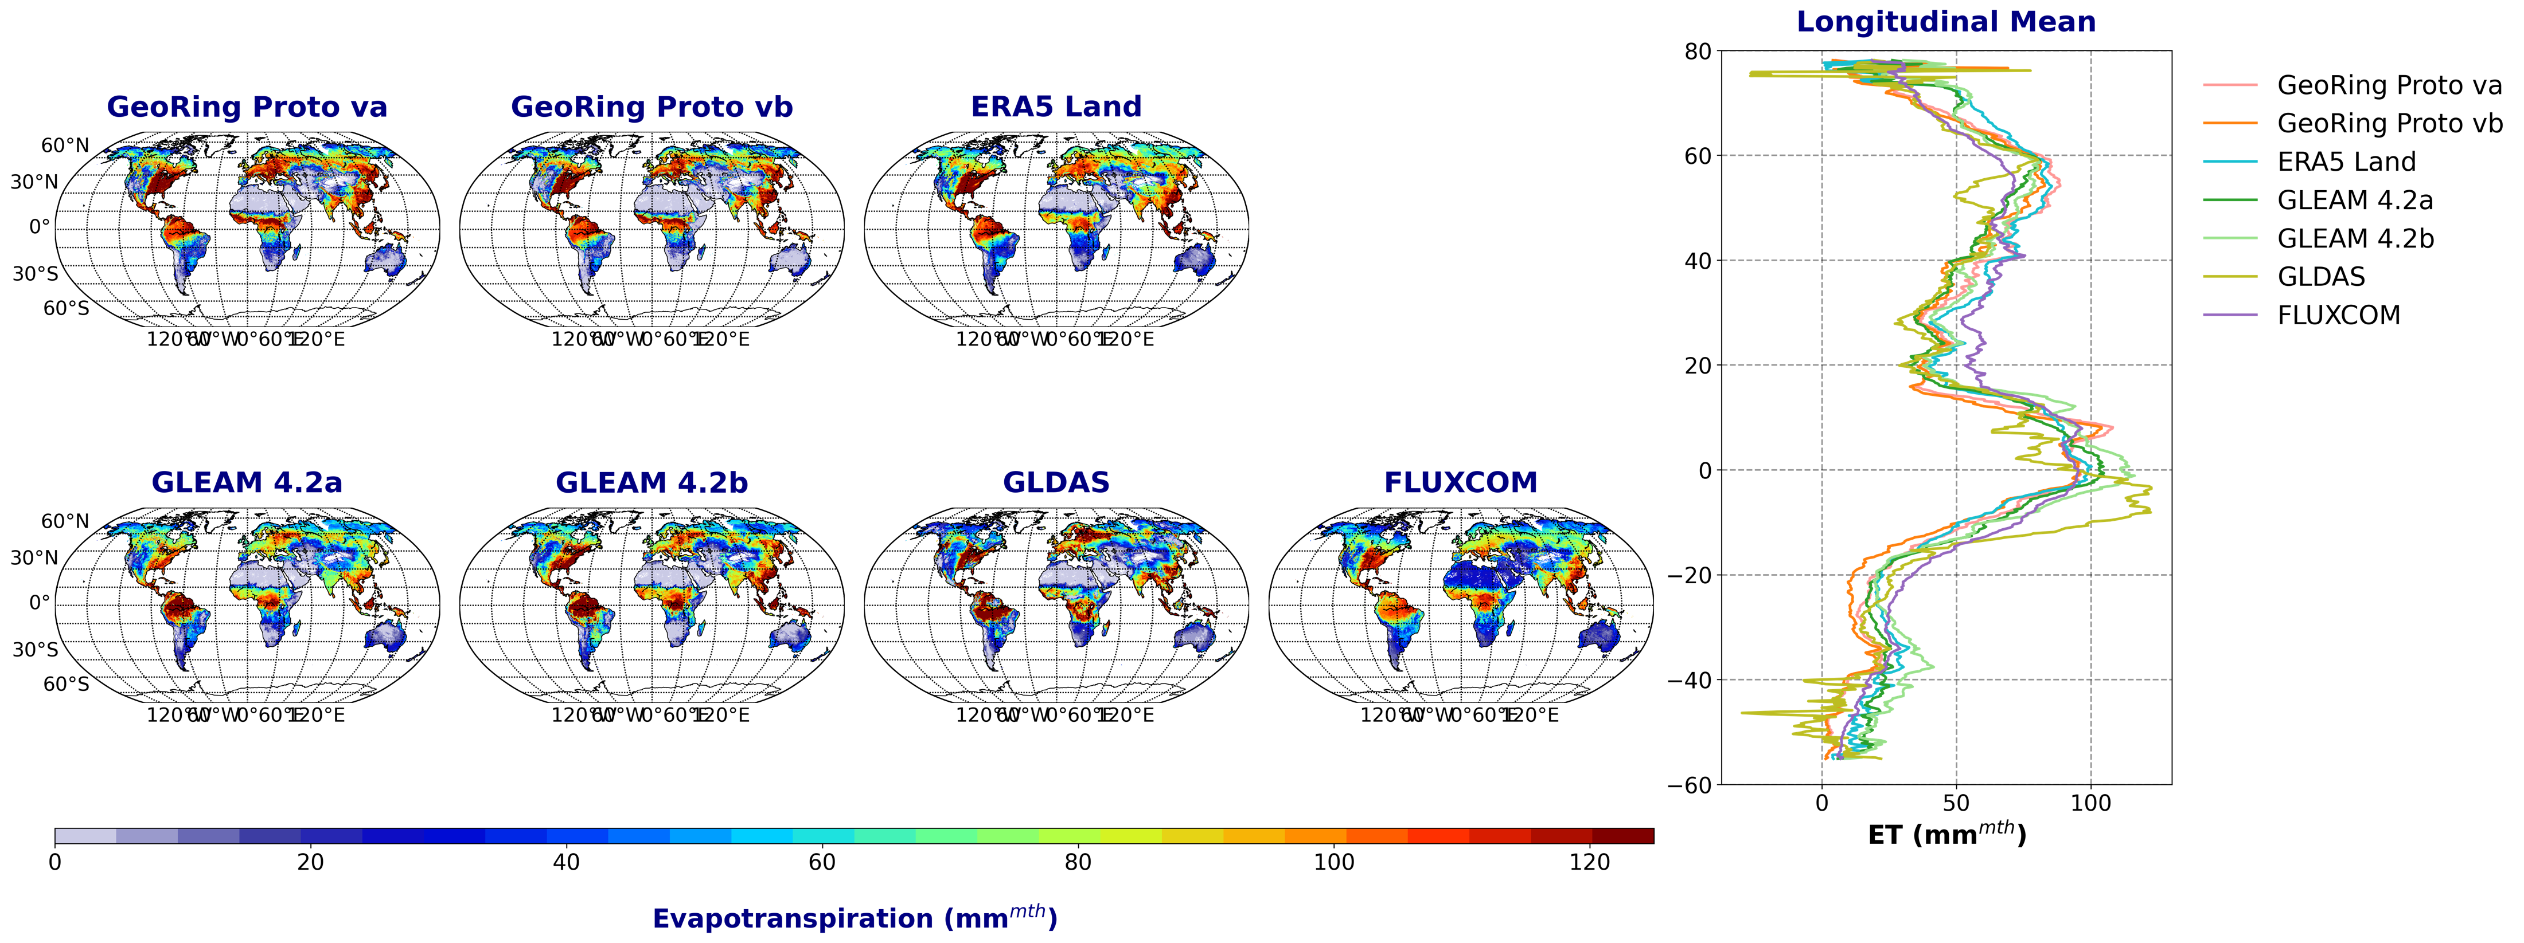
Preliminary results – Seasonal map
JJA
Successfully capture the expected global spatial patterns
Demonstrate consistency with established reference datasets
Exhibit localized higher values around 10°N (investigation ongoing)
Remapped to a common 0.25° grid

Slide 4
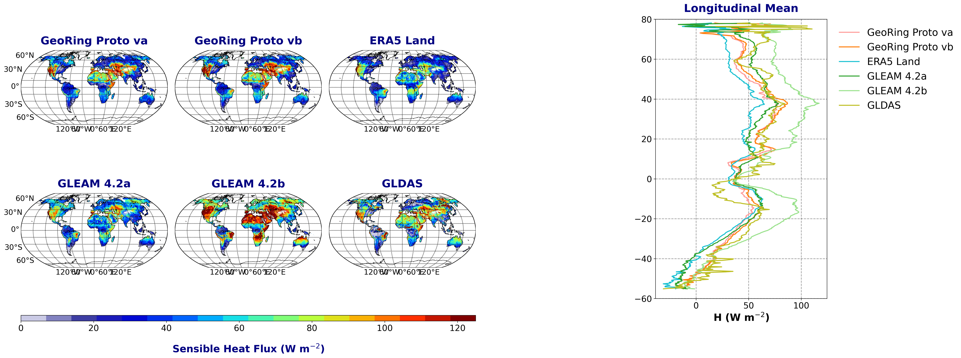
Preliminary results – Seasonal map
JJA
Successfully capture the expected global spatial patterns.
Exhibit higher variability and a wider spread across all reference datasets.
Fall within the ensemble range.
Remapped to a common 0.25° grid

Slide 5
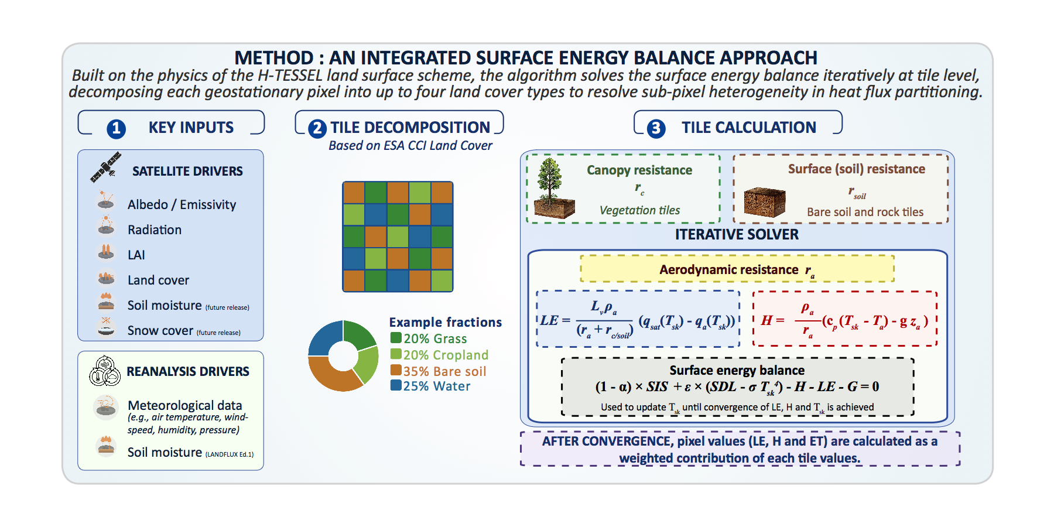
Method

